Slide 1
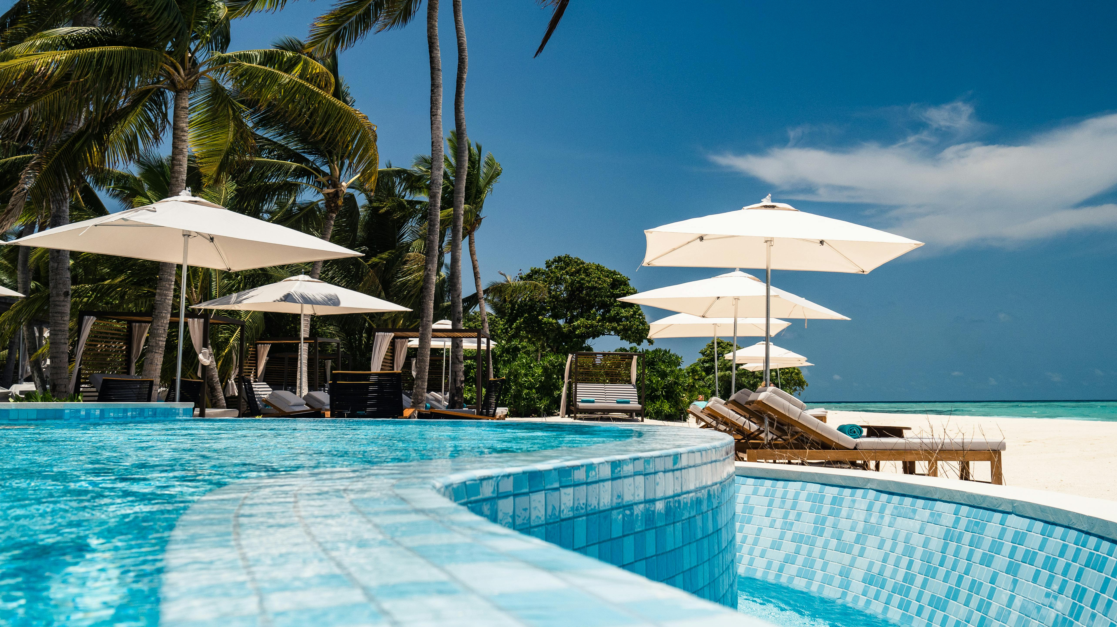
Luxury. comfort
Home
Resorts
Booking
Info
Holiday Resort
“WELCOME To Our Holiday Resort where Comports Meets nature and every stay becomes a beautiful memory.”
Contact Now

Slide 2
Project Title: Holiday Resorts
Group Members:
Mirha Tayyab (2025-GA-95)
Tahreem Imran (2025-GA-91)
Hamayal Ansari (2025-GA-71)
Syed Abbas Haidar (2025-GA-98)
Abdullah Usman (2025-GA-81)
Domain: Gaming and Animation
Instructor :Ms. Ramsha Khalid

Slide 3
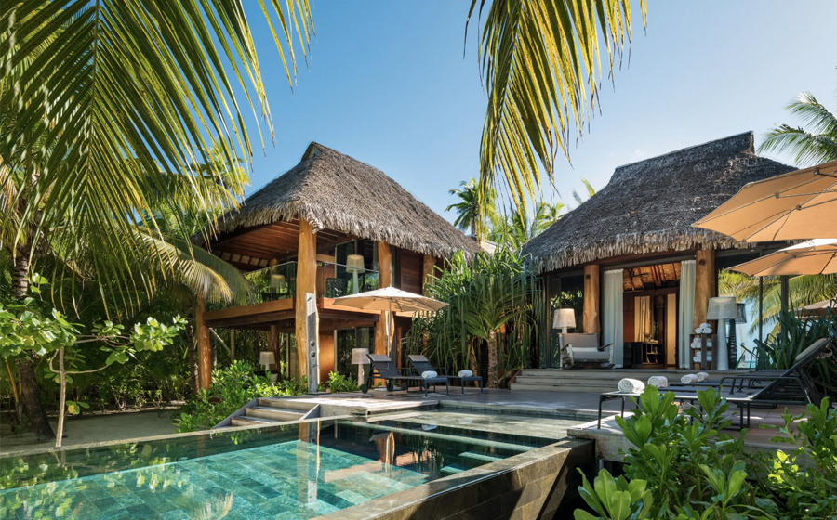

Luxury. comfort
Contact
Home
About Us
Info
INTRODUCE OUR RESORT
About Us
Pakistan Resort is your ultimate guide to exploring the most luxurious and iconic resorts and iconic resorts across in Pakistan.
Modern Facilities, peaceful environment and
friendly environment staff, we are dedicating to
making every guests holidays truly special.
We are committed to providing a comfortable, peaceful , and memorable
Resorts experience for every guest.

Slide 4
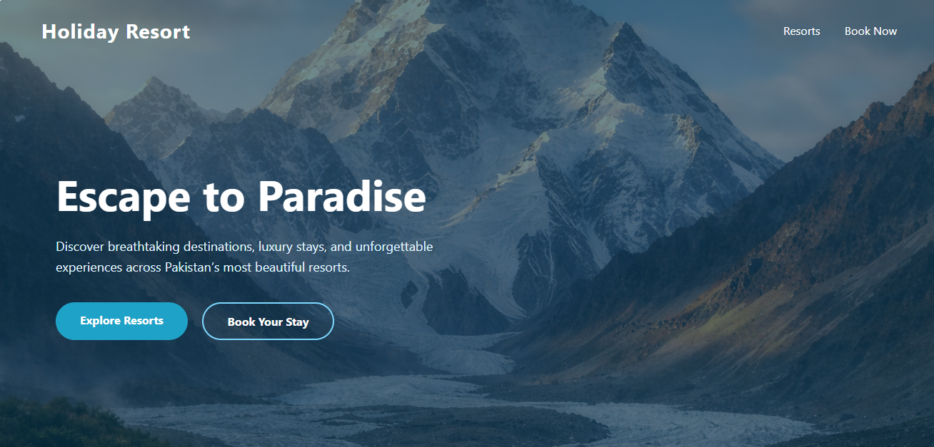
HOME PAGE
Welcome to Holiday Our Resort, where tranquility meets luxury. Nestled in the heart of nature, our resort offers the perfect escape from the hustle and bustle of everyday life. Enjoy comfortable accommodations, world-class amenities, and a range of activities designed to relax, refresh, and rejuvenate you. Whether you seek peaceful moments by the pool, adventurous outdoor experiences, or quality time with your loved ones, Holiday Our Resort provides an unforgettable getaway that blends comfort, beauty, and serenity in every moment.

Slide 5
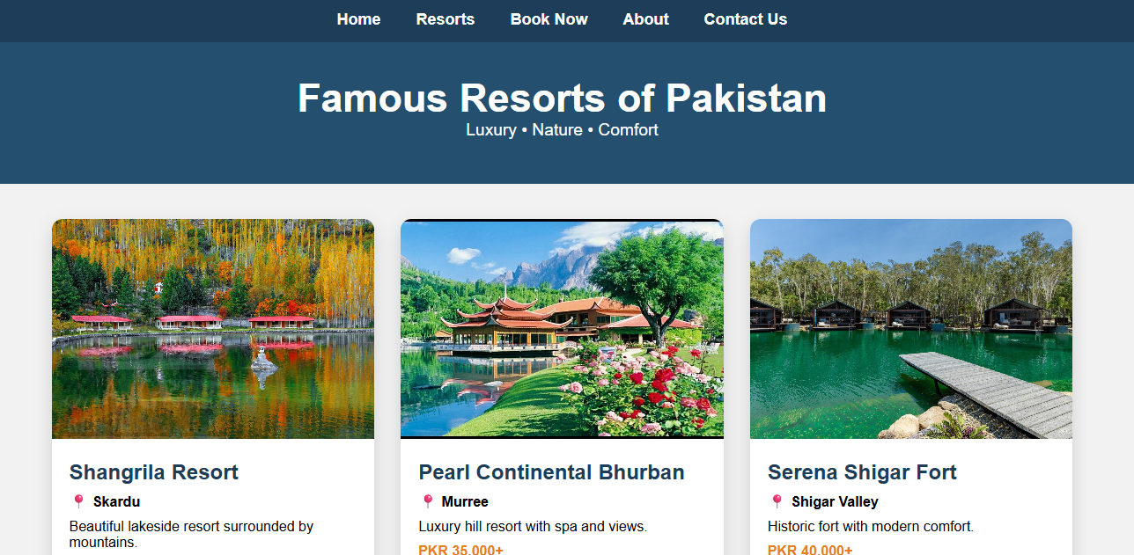
RESORTS
Resorts are more than just places to stay—they are destinations for relaxation, adventure, and unforgettable experiences. Combining comfort, luxury, and nature, they offer scenic views, fun activities, and personalized services. Whether you seek peace or excitement, resorts provide the perfect escape to rejuvenate, explore, and create lasting memories.

Slide 6
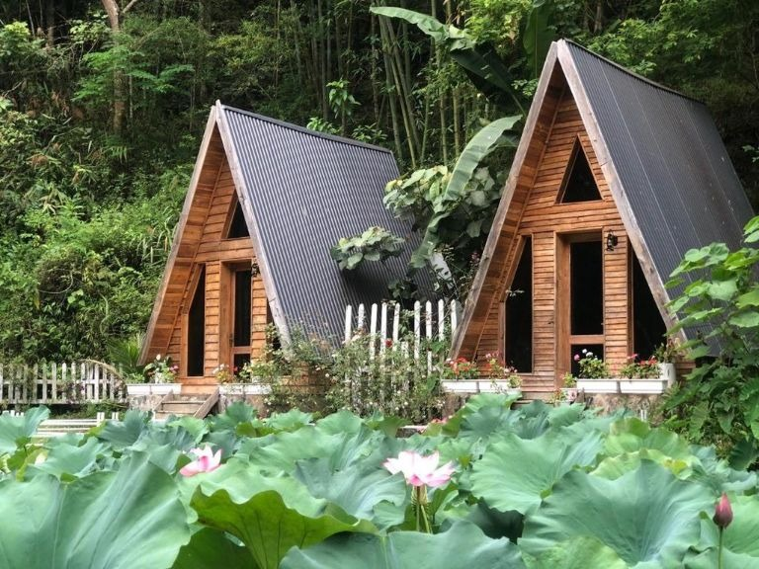
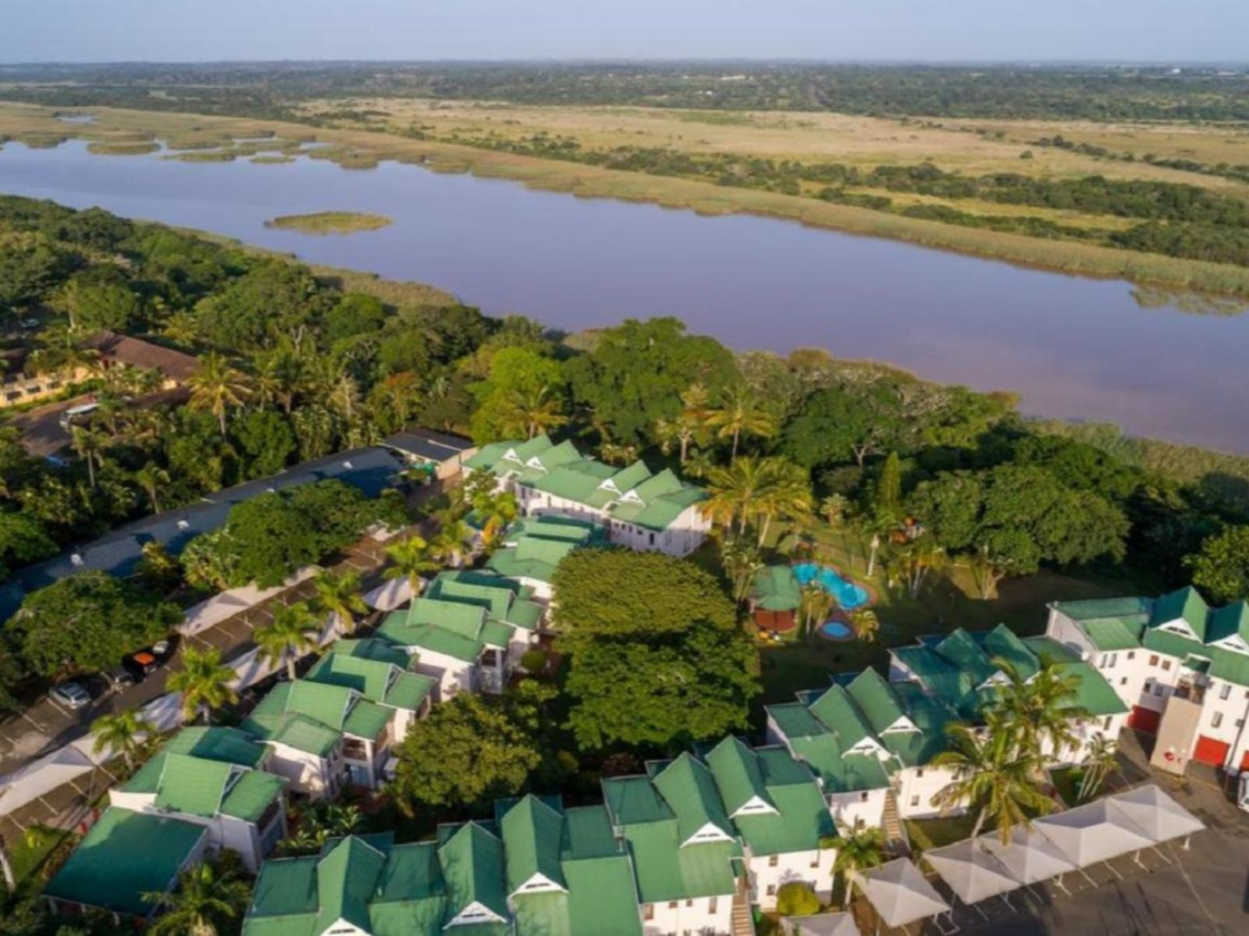
Luxury. comfort
Home
About Us
Contact
Info
OUR VISION & MISSION
🌿 Our Mission
To provide a peaceful and luxurious retreat where guests can relax, reconnect with nature, and create unforgettable memories.
To deliver exceptional hospitality, comfort, and personalized services that exceed guest expectations.
Vision
To became a leading holiday resort known for natural beauty, quality service, memorable guest experiences.
To remote sustainable tourism while offering a perfect blend of relation, adventure and comforts.

Slide 7
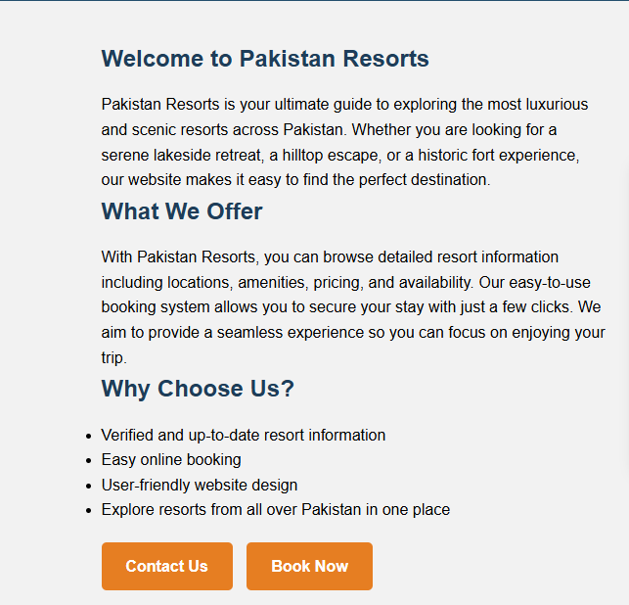
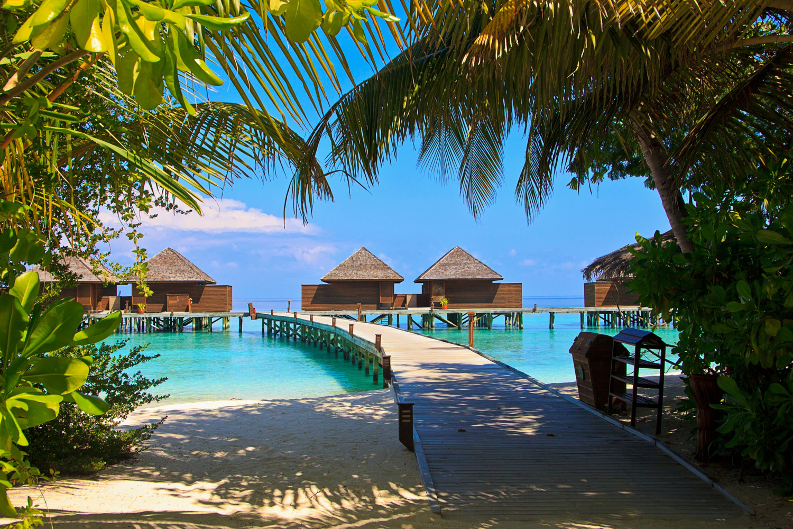
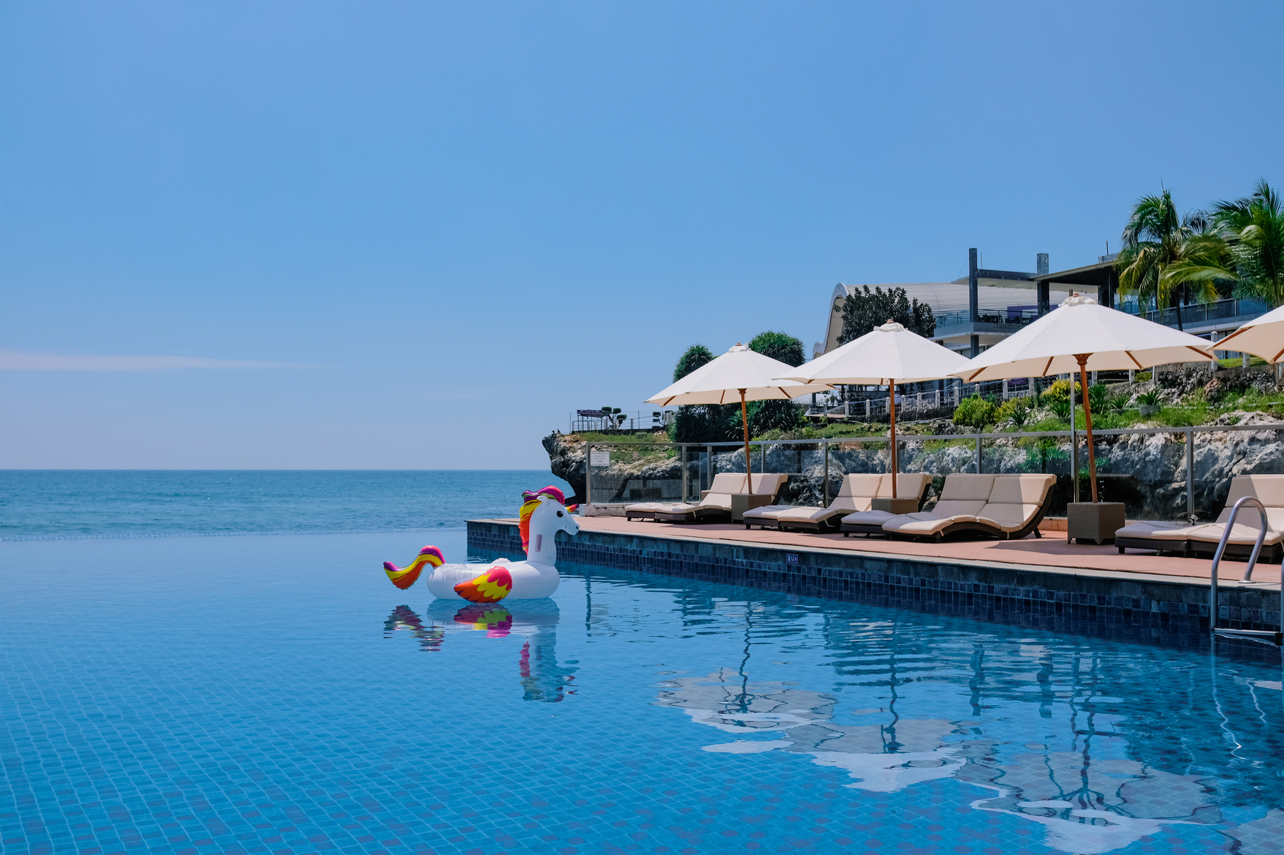
ABOUT

Slide 8
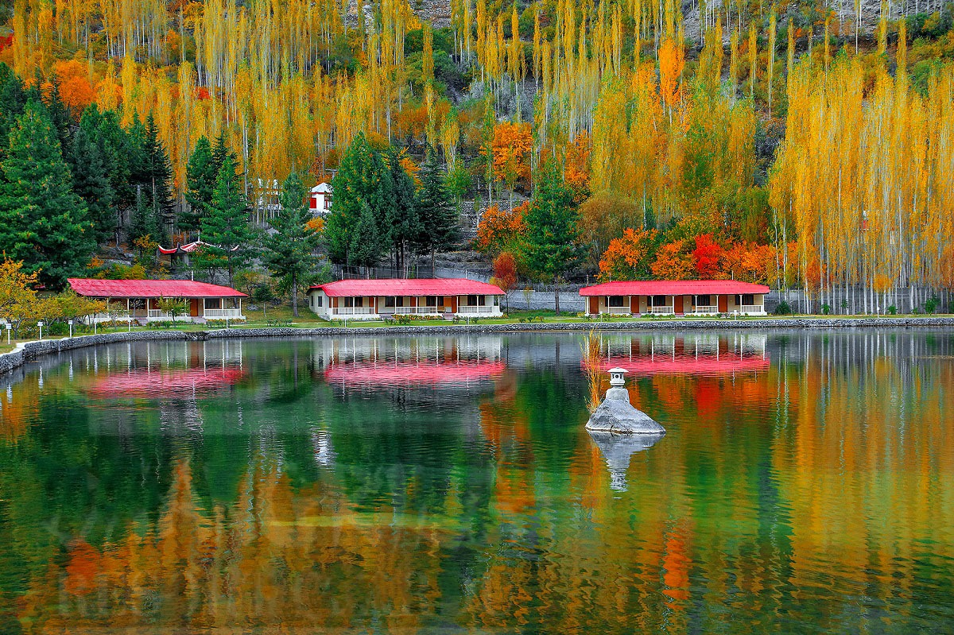
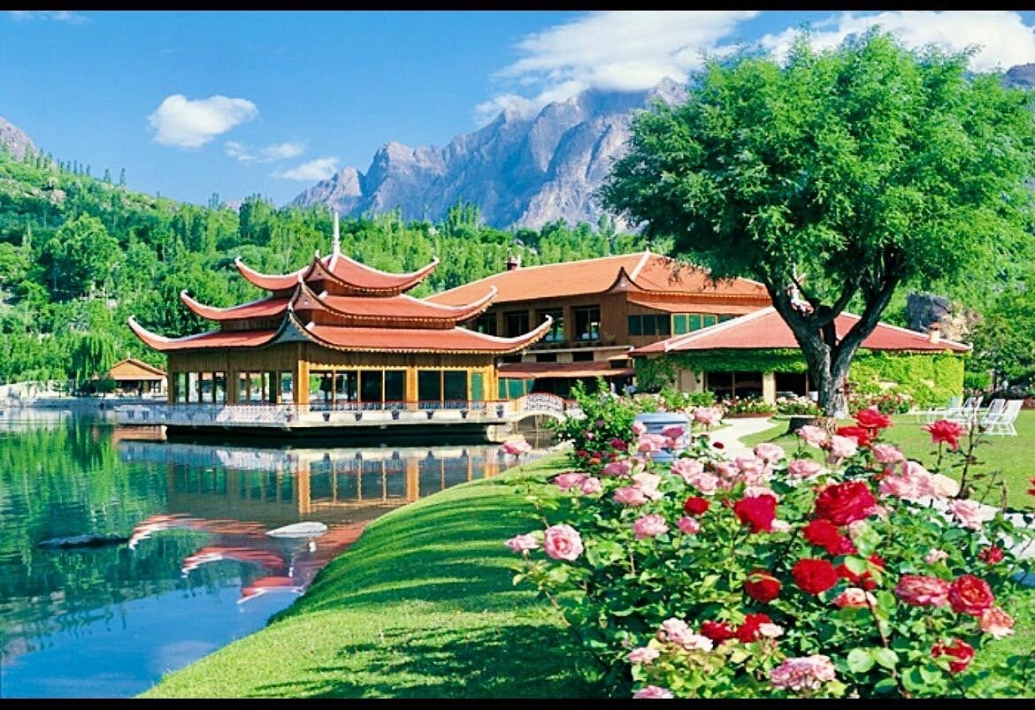
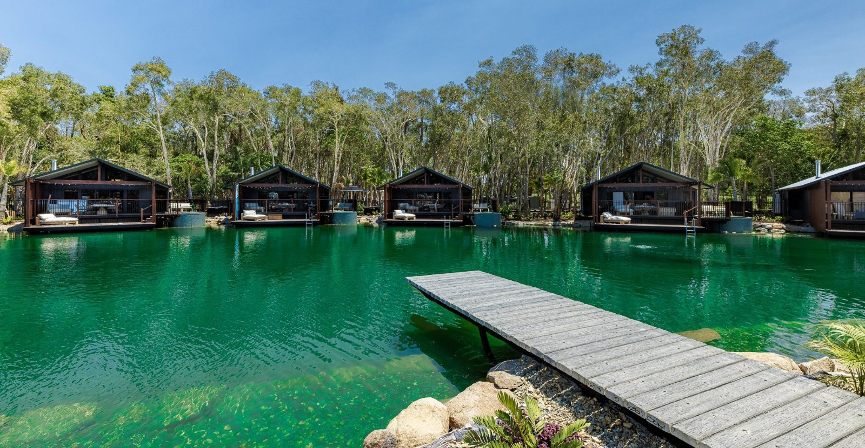
RESORTS INFORMATION
RESORT INFORMATION
01
02
03
Shangrila Resort
📍 Skardu, Gilgit-Baltistan
Serena Shigar Fort
📍 Shigar Valley, Gilgit-Baltistan
Pearl Continental Bhurban
📍 Murree, Punjab

Slide 9
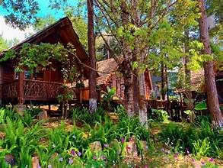
RESORT INFORMATION
04
05
06
Monal Resort
📍 Margalla Hills, Islamabad
Lakeside Resort Khanpur
📍 Khanpur Dam, Khyber Pakhtunkhwa
Nathia Gali Forest Resort
📍 Nathia Gali, Khyber Pakhtunkhwa

Slide 10
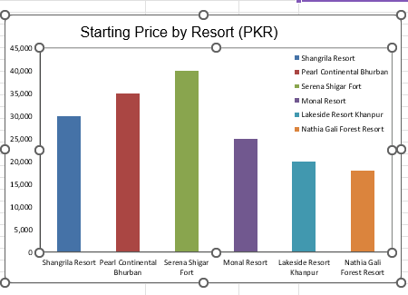
DATA OVERVIEW FROM EXCEL
Log In
This bar chart shows the starting prices of different holiday resorts in Pakistan (PKR). From the comparison, Serena Shigar Fort has the highest starting price at around PKR 40,000, showing its premium and heritage experience. Pearl Continental Bhurban and Shangrila Resort also fall in the higher price range, indicating luxury services. On the other hand, Monal Resort, Lakeside Resort Khanpur, and Nathia Gali Forest Resort have relatively lower starting prices, making them more affordable options for tourists while still offering quality stays.

Slide 11
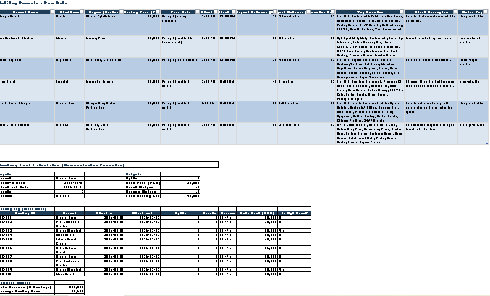
DATA OVERVIEW FROM EXCEL
This slide presents key details of all resorts, including pricing, amenities, and locations. It includes a booking cost calculator that estimates total costs based on nights, guests, and season. The sample booking log and summary metrics highlight total revenue, average booking value, and high-value reservations, providing a clear view of booking trends and resort performance.

Slide 12
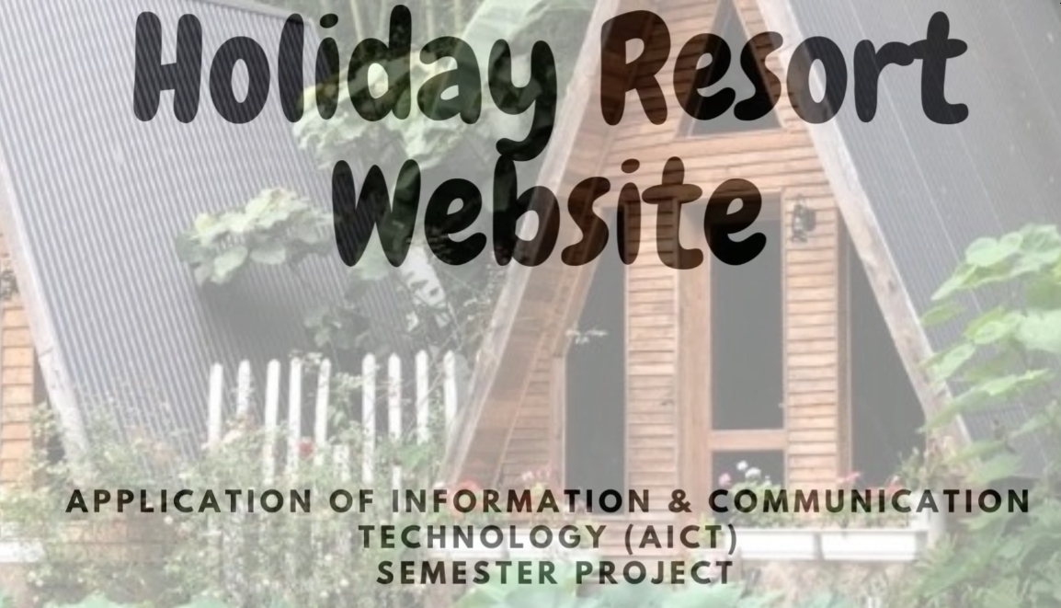
VIDEO ANIMATION SCRIPT
This slide showcases our holiday resorts with engaging visuals and animations. Short video clips highlight scenic views, resort amenities, and guest experiences, while text animations emphasize key features like pricing, packages, and services. The use of subtle motion and dynamic visuals makes the presentation lively and gives viewers a real feel of the resort environment.

Slide 13
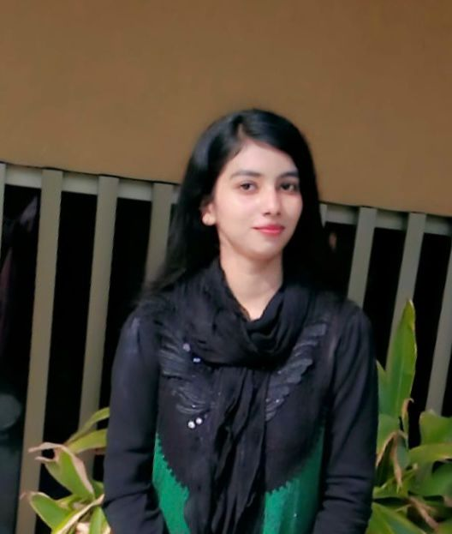
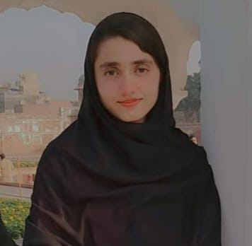
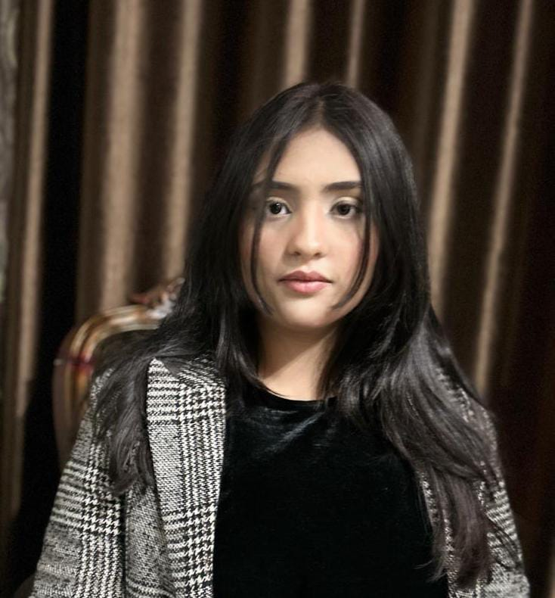

Luxury comfort
Home
About Us
Contact
Info
MEET OUR BEST TEAM
HAMAYAL ANSARI ADMIN: Hamayal Ansari efficiently manages resort operations, ensuring everything runs smoothly and guests have a seamless experience.
TAHREEM IMRAN ADMIN:
Tahreem Imran manages daily resort operations with dedication,
smooth workflows and excellent guest satisfaction.
MIRHA TAYYAB ADMIN:
Mirha Tayyab efficiently oversees resort activities, making sure every guest
experience is smooth and enjoyable.
SYED ABBAS HAIDER ADMIN:
Syed Abbas Haider ensures smooth resort operations and helps provide a seamless experience for all guests.
ABDULLAH USMAN ADMIN:
Abdullah Usman keeps the resort running like clockwork, blending efficiency with a personal touch for every guest.

Slide 14
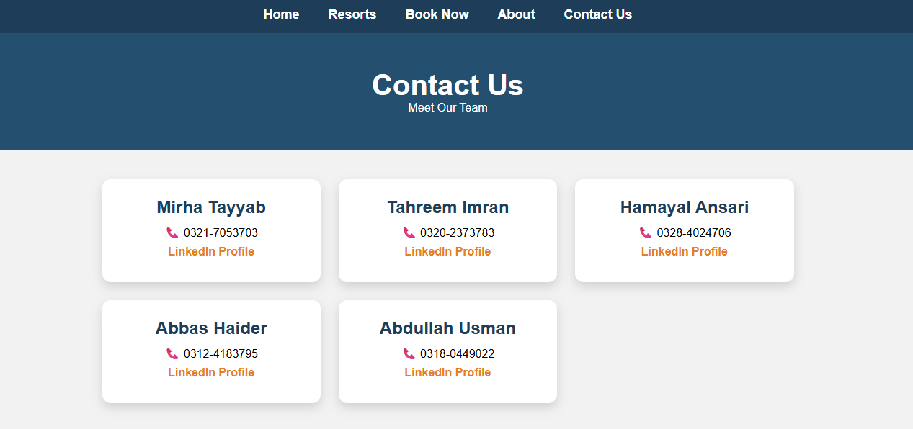
OUR CONTACT
The Contact page lets users quickly get in touch using a simple form with Name, Email, and Message fields. It also shows our email and location for easy support.
GIT HUB LINK
https://mirhatayyab.github.io/resortwebsite/
WEBSITE LINK
file:///C:/Users/it/Downloads/meow/meow/resort/index.html

Slide 15
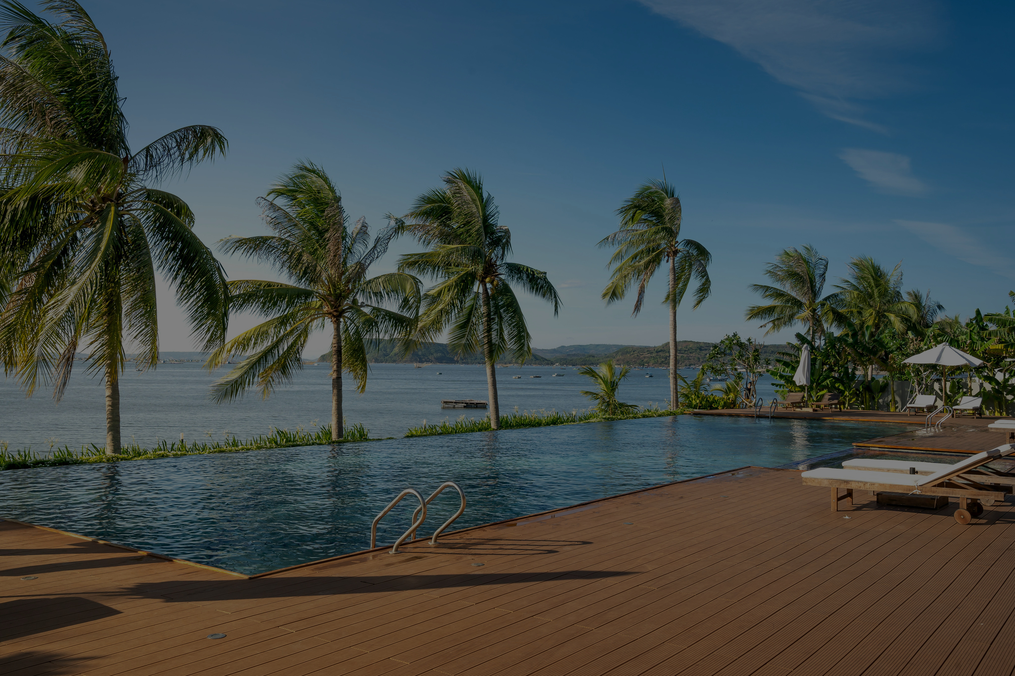
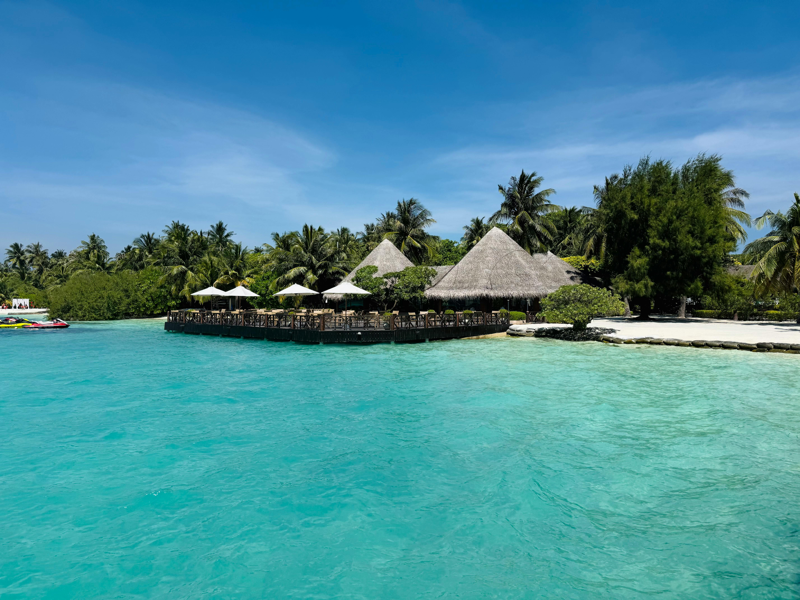
Thank You

